Slide 1
Real Property – PST Changes
Information Session
in conjunction with the
Saskatchewan Construction Association
Presenter: Jeff Harrison, CPA, CMA
Senior Manager – Indirect Tax
Date: May 1, 2017

Slide 2
Legal Caveat
The information contained in this document contains a general overview of the subject, is provided solely for educational and informational purposes, and may not be applicable to a specific case, set of circumstances or facts. This material is based on laws and practices that are subject to change and may not represent the views of MNP LLP and/or Saskatchewan Finance. This general information is current as of the date of the document and should not be regarded as a substitute for professional advice.

Slide 3
Legal Caveat
Although information has been carefully prepared, MNP LLP accepts no responsibility or liability to the Saskatchewan Construction Association Inc, any of its members or any other third parties for any loss or damage cause by any reliance on information contained in this presentation. Any party relying on the information provided by MNP LLP does so at their own risk and any use of reliance upon same is done so on the basis that MNP LLP shall be held harmless by such party.

Slide 4
Presenter
26 yrs specialist in GST/HST and PST
19 yrs in public practice with major professional advisory firms as an indirect tax specialist;
Senior manager with MNP LLP;
CMA designation in 1998;
Based in Regina, Sask.

Slide 5
Agenda:
Overview
Real property in general
New PST rules
Transitional Period

Slide 6
Overview
Categorical change to the tax status of real property services
Impacts sale of NEW real property structures
Almost all construction, repairs, alterations, improvements to land, buildings, structures – taxable on retail price
Sale of LAND - Exempt
Sale of USED buildings/structures - Exempt
Lease of new or used real property - Exempt

Slide 7
What has happened
Old Rules
Contractor/Subcontractor
Purchaser
Materials (PST Paid goods)
Labour/OH
/Profit (Exempt)
PST Paid at source
New Rules
Contractor/Subcontractor
Purchaser
Materials (PST Taxable)
Labour/OH
/Profit (Taxable)
Acquire taxable goods/services on Exempt basis
PST Paid
Notes:
The change will move the PST tax application from the contractor/subcontractor being a consumer throughout the supply chain;
The shift pushes the tax collection between the final supplier and the final consumer in the more traditional retail sale concept;
Appears to bring with it a reduced tax leakage occurring with non-resident contractors doing business in Saskatchewan → PST borne at final consumer stage rather than by way of non-resident contractor responsible to pay PST on materials used
Non-resident contractor (and resident contractors) still have the obligation to pay tax on the equipment, tools, vehicles used to perform the contract.
We also see a shift in the amount of PST on the transactions → retail selling price results in tax applying to labour, overhead and profit

Slide 8
Old PST Rules
PST Applies
PST Exempt
PST Exempt
Supplier
Sub Trade
General
Customer
“Consumer” was subcontractor and/or general contractor in many arrangements;
PST paid on materials used
Supplier
PST applies
Notes:
Whether the subtrade, the general contractor, or the actual customer acquiring the services, the tax applied to who consumed the materials in the performance of the contract (e.g.; customer directly, or general/subtrade in relation to performance of the contract).
PST applied on the materials, the subsequent supplies were PST-included pricing.
Consumer tended to be the supplier before the final customer – resulted in embedded PST in prices (PST included, no separate charge for PST was visible)

Slide 9
New PST Rules
PST Exempt
PST Exempt
PST Taxable
Supplier
Sub Trade
General
Customer
“Consumer” is now the customer
Taxable goods/services used now acquired exempt
Tax on retail selling price
(labour, OH, Profit now taxed)
Supplier
PST Exempt
Quote PST # to buy exempt
Notes:
The change affect the supply chain;
Supplier making a taxable supply but purchaser will supply PST licence number to acquire on a PST exempt basis (acquiring for further resupply)
Supply is now a taxable service to real property; it is as well subject to PST and relieved by way of the purchaser providing their PST licence number to eliminate the obligation to collect PST;
This process continues in the supply chain until the end user/consumer, whereby they pay PST on the retail selling price
Materials are no longer subject to PST in the provision of the taxable service to real property – dynamic shift in how the industry has been practicing;
Requires more tax to be collected and reported, more frequent reporting process likely to result as well
Removes some risk from the suppliers and subcontractors as they are buying retail; general and/or principal may have the highest risk → need to determine supply is taxable or exempt (e.g.; new tax base rules or old tax base rules, who is the end user/consumer, etc.)

Slide 10
Taxable Real Property Services
Construction
Repair/Demolish
Altering/Improvement
Erecting new structures
Remodelling/renovation
Related services (warranties, maintenance contracts, insurance premiums)
Notes:
Insurance premiums – starting July 1, 2017
Extended warranties and maintenance contracts in relation to services to real property taxable under the new tax base rules;
Almost all these services became taxable that were exempt before;
Not just new construction;
Applies to a lot of different industries like oil, gas, and potash. Lot hitting just the traditional construction industry
The target is the construction services, but also NEW construction on the subsequent sale (building, not land)
Land development – owner should expect to pay PST on the real property services acquired – resale of land is exempt
Lease of buildings, sale of used buildings - exempt

Slide 11
Examples:
Build a new house, commercial/industrial building (land sale is exempt)
Road construction
Install a gas line, water line, pipeline, etc.
Renovate interior/exterior of a building
Install facia, soffits, eavestrough
Install HVAC, plumbing, electrical, etc.
Repair/alter/improve any of the above, etc.
Notes:
Service to crush gravel owned by a municipality or Ministry of Highways/Infrastructure is PST exempt
Supply only on sales of sand, gravel, and crushed/screen bases to municipalities and Ministry of Highways/Infrastructure is PST exempt
Other exemptions may apply depending on who is the purchaser (e.g. FN, Highways, etc.)
Home inspections – exempt
Home appraisals – exempt
Damage appraisals (insurance or valuation purposes) – exempt

Slide 12
Maintain Real Property
Maintenance services are not taxed
Caution on defining what is maintenance vs repair
Maintenance: Snow clearing, lawn care, etc.
Grade a road – taxable service to real property
Install sod, sprinkers – taxable - service to real property
Maintain lawn (e.g.; spray for weeds) - Exempt
Use bobcat to clear snow – Exempt services
Use bobcat to fill/repair potholes in road – Taxable service
Notes:
Waste disposal services – exempt
Dust suppressant on roads – PST taxable services
Sanding a road (e.g. winter) – exempt

Slide 13
Land Development
Infrastructure going into land – PST taxable on retail selling price
Sale of land remains exempt
WATCH to ensure PST is paid on taxable services to real property and tangible personal property going going into the land
Sale of new structure (FMV of land is not taxed; new structure is taxable)
Notes:
Roads
Landscaping
Bridges
Sewer systems
Water supply
Electrical grids
Telecommunication systems
Etc.

Slide 14
Renovations
Old tax base rules followed on projects underway and/or contracted before April 1, 2017;
Contracted after March 31, 2017:
Renovation service taxed on entire service
If doing renovations for yourself (e.g.; in a business, for your business), PST payable on materials;
If contracted – entire price
Internal labour component on your own renovations is not self-assessed
If charging for services, retail selling price rules apply (e.g.; new rules)
Subsequent sale of property – PST exempt
Notes:
Not adopting the GST concept of substantial renovation (90% or more of interior gutted and redone to result in a new property);
Used buildings, structures are not subject to PST;
Renovations would be subject to PST on the taxable services and payable by the final user/consumer
We may have scenarios where the labour on the renovation may have to be self-assessed in addition to PST payable on the materials.

Slide 15
Transition Rules
Agreement in place before April 1, 2017
Contractor and subcontractors to that original agreement are grandfathered under old rules
NEED EXECUTED DOCUMENTS TO SUPPORT THIS!
NOT ALL SUBCONTRACTORS WILL BE GRANDFATHERED
Work that is tendered and closed before April 1, 2017 should fall to old tax base rules
Bids, letters of intent, PO’s – not sufficient on their own
MUST have documented support old rules are eligible to be followed
Invoicing would continue under old rules
This period may be closed off in the near future
Notes:
Seek clarification on contracts to be completed in stages or phases as Sask Finance has indicated these may not be under the old tax base rules for work completed after March 31, 2017;
PST rate is 6% after March 23, 2017
PST credits not eligible on work completed under old tax base rules.
Per IN2017-17 Land Development and Residential and Commercial Construction Application of PST and Transitional Rules
Executed service agreement in place prior to April 1, 2017
Can be work bid and responded to (awarded) prior to April 1, 2017 – formal submission process and a written letter of award has been received within 60 calendar days of April 1, 2017
Support can include: project tender documents, engineering estimate of costs to complete work in the phase, executed sub-trade agreements, purchase orders, sub-trade award letters, proposed plan of the subdivision (as relevant to the contract)

Slide 16
Transitional Rules – Old Rules Land Developers/Contractors
One of more of these conditions need to be met:
Executed service agreement in place prior to April 1, 2017
Work was solicited and awarded prior to April 1 (within 60 calendar days letter of award must be received)
NEED SUPPORTING DOCUMENTS

Slide 17
Transitional Rules – Old Rules Developers/Builders/Contractors
One of more of these conditions need to be met:
Executed contract in place in place prior to April 1, 2017, or an offer available for acceptance with a 30 day period in place prior to April 1, 2017 (price has been determined)

Slide 18
Transitional Rules – Old Rules Developers/Builders/Contractors
One of more of these conditions need to be met:
Executed contract in place in place prior to April 1, 2017, or an offer available for acceptance with a 30 day period in place prior to April 1, 2017 (price has been determined)

Slide 19
Transitional Rules – Old Rules Developers/Builders/Contractors
One of more of these conditions need to be met:
2) Residential or commercial building is under construction before April 1, 2017;
3) Based on dollar value majority of subtrade agreements have been entered into before April 1, 2017
NEED SUPPORTING DOCUMENTS

Slide 20
Phased Development
Those phases that qualify under the old rules -> follow old rules through completion (change order exception)
Therefore, phase by phase project work must be considered carefully

Slide 21
Transitional - Change Orders
First change order that causes total to exceed 10% (and all subsequent change orders) fall to new PST rules
Based on original contract price and change orders up to March 31 (becomes the new value to measure the 10% change)
Cumulative change order measured April 1, 2017 onward
Once exceeds 10% - all post-10% change orders subject to PST on retail selling price (taxed at 6% rate)

Slide 22
Transitional - Change Orders
Agreements that include conditions yet to be removed that impact pricing
These are treated as change orders
If under old rules, watch for 10% limit

Slide 23
Transitional Rules
Master Services arrangements not eligible
Open ended agreements to provide services as needed
Not viewed as specific arrangement to be grandfathered
New rules apply for service provided after March 31, 2017

Slide 24
Transition Specifics Pre-April 1, 2017
Builds under pre-April 1, 2017 contract remain under old rules
Inventory for sale (e.g. new houses, spec houses, etc.) – Exempt on sale
In-progress construction – exempt on sale or on construction services
PST paid on materials not eligible for credits
Notes:
Lots of questions have been raised on new houses, spec house, houses not yet completed.
Providing there is support they are under the old tax base rules, the PST will continue to be paid on the materials consumed (6% rate after March 22, 2017)

Slide 25
Transitional - Inventory
PST paid materials are eligible for a credit when in relation to NEW rule application
Credit is used to reduce PST collectible in a subsequent return
Cannot create a refund; claim remaining credit in another PST return
DOCUMENT support for the PST credits
Notes:
A refund cannot be claimed directly from Sask Finance;
Track PST credits correctly, and at which rate of PST;
Cannot obtain a PST credit for material used in relation to real property contracts under the old tax base rules.

Slide 26
Examples – Existing Services
Old tax base rules:
Building inventory completed prior to April 1st
Builds under construction prior to April 1st
Agreements in place prior to April 1st, construction not started
Constructed house/commercial/industrial building completed or under construction prior to April 1 and subsequently leased
Subtrades to these contracts – old rules
Notes:
The challenge will be to manage the contract through to completion;
How do the subtrades support they are under the grandfathered contracts;
They must pay the PST on the materials used, as does the general contractor/principal;
If a subtrade is not willing to remain under the grandfathered rules, how will the PST be handled as PST on the cost of materials is not going to be identified;
Think ahead to a future audit – how can you demonstrate the old and new tax base rules during this time of transition

Slide 27
Examples – New Services
New Rules
Construction contract not in place by March 31st (subtrades to the main contract also under new rules)
Construction/alteration/improvement contracted after March 31
New builds, construction services, renovations, etc
Change orders >10% on a cumulative basis from Apr 1/17 onward (e.g.; contract under old rule); 6% PST applies on change orders beyond the 10%.

Slide 28
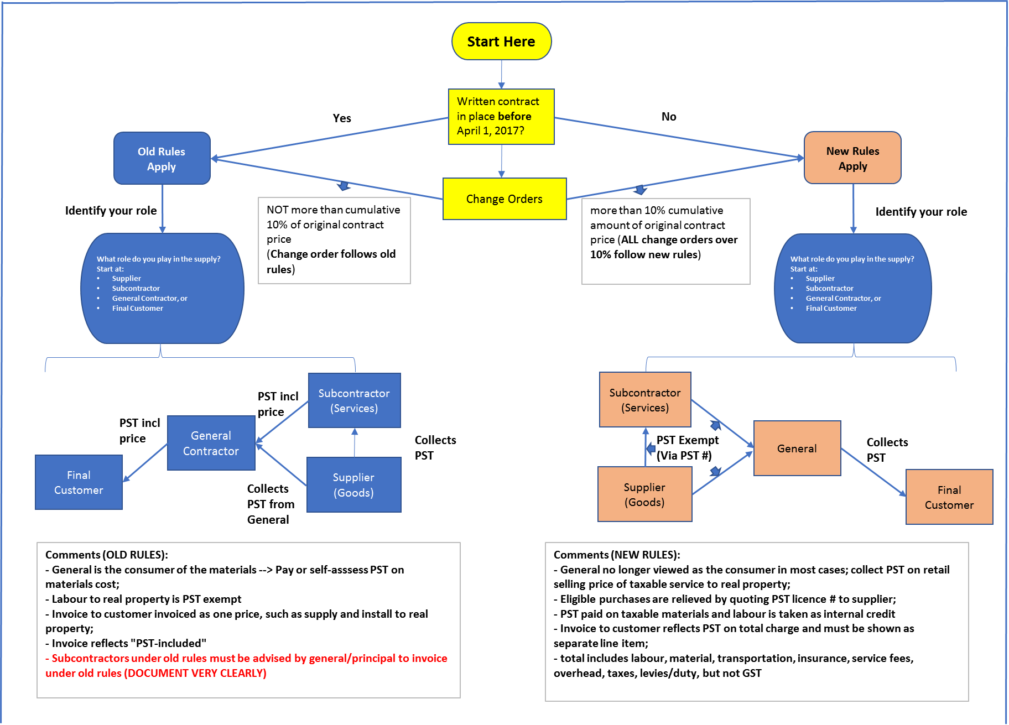
 | Real Property Contracts - PST Changes 2017
Grandfathere Rules |  |  |  |  |  |  |  |  |  |  |  |  |  |  |  |  | New Real Property Rules

Slide 29
Words of Caution
DOCUMENT why you are under the old rules during period of transition
RISK is 6% on labour, overhead, profit you may have missed collecting or paying
CANNOT use PST account to buy goods for own use on PST exempt basis
Don’t abuse the PST account – intended to buy taxable goods/services for further resale
Equipment, tools, consumables, etc. are for use in providing services for example

Slide 30
Words of Caution
Rules are evolving
When in doubt – seek a ruling from Sask Finance or professional advice to interpret
PST is very administrative and policy driven

Slide 31
Thank – you !
Jeff Harrison
MNP LLP
(306) 751-7998
jeharrison@mnp.ca

